Slide 1
Employee Data Analysis using Excel
STUDENT NAME: Lathika.V
REGISTER NO: 122204001
DEPARTMENT: B.Com (CS)
COLLEGE: Shri Krishnaswamy college for women

Slide 2
PROJECT TITLE
Employee Performance Analysis using Excel

Slide 3


AGENDA
Problem Statement
Project Overview
End Users
Our Solution and Proposition
Dataset Description
Modelling Approach
Results and Discussion
Conclusion
3/21/2024 Annual Review

Slide 4

PROBLEM STATEMENT
Identifying gender in a company can serve several purposes:1.
Diversity and Inclusion: Tracking gender helps companies
monitor and improve gender diversity, ensuring a more
inclusive workplace.2. Equal Opportunities: Gender
identification helps ensure equal opportunities in hiring,
promotions, and career development.3. Pay Equity: Analyzing
gender helps identify potential pay gaps and ensures fair
compensation practices.4. Workforce Planning: Understanding
gender demographics informs workforce planning, talent
development, and succession planning.5. Compliance: In some
countries, companies are required to report gender
demographics for regulatory compliance.6. Benchmarking:
Companies can benchmark their gender diversity against
industry averages or competitors.7. Creating Support
Programs: Identifying gender helps companies develop
targeted support programs, such as mentoring or employee
resource groups.Remember, the goal is to promote diversity,
equity, and inclusion, not to discriminate or stereotype. Gender
identification should be used to create a more inclusive and equitable work place

Slide 5

PROJECT OVERVIEW
-Monitor and improve gender diversity and inclusion
- Ensure equal opportunities in hiring, promotions, and career
development
- Identify and address potential pay gaps
- Develop targeted support programs and resources
- Comply with regulatory requirements
Your participation in providing gender information is voluntary
and confidential. We value and respect individual privacy and
identity. The data collected will be used solely for aggregate
reporting and analysis to support our diversity and inclusion initiation
.

Slide 6

WHO ARE THE END USERS?
The end users of gender identification in a company setting may include:1. HR
Department: To monitor diversity metrics, ensure equal opportunities, and develop
inclusive policies.2. Management and Leadership: To understand workforce
demographics, make informed decisions, and promote diversity and inclusion.3. Diversity
and Inclusion Teams: To develop targeted initiatives, support programs, and resources.4.
Compliance Officers: To ensure regulatory compliance and reporting requirements.5.
Researchers and Analysts: To study and analyze gender trends, gaps, and opportunities.6.
Employee Resource Groups (ERGs): To support and advocate for employees with shared
experiences and backgrounds.7. Business Leaders and Decision-Makers: To inform talent
development, succession planning, and business strategy.8. Government Agencies and
Regulatory Bodies: To comply with reporting requirements and regulations.These end
users may utilize gender identification data to:- Develop inclusive policies and practicesImprove diversity and representation- Address pay gaps and equal opportunities- Create
targeted support programs- Inform business decisions and strategy- Comply with
regulations and reporting requirementsRemember, gender identification should always prioritize respect and Privacy.

Slide 7

OUR SOLUTION AND ITS VALUE PROPOSITION
Here's a potential solution and value proposition for gender
identification:*Solution:* "Inclusive Insights" - A confidential
and voluntary gender identification program that enables
companies to collect, analyze, and act on gender diversity
data.*Value Proposition:*1. *Accurate Diversity Metrics*: Gain
a deeper understanding of your workforce's gender
demographics to inform diversity initiatives.2. *Data-Driven
Decision Making*: Use actionable insights to address gender
disparities, improve equal opportunities, and develop targeted
support programs.3. *Enhanced Inclusion*: Foster a more
inclusive culture by acknowledging and valuing the diversity of
your employees.4. *Compliance and Risk Management*:
Ensure regulatory compliance and mitigate potential risks
associated with gender discrimination.5. *Talent Attraction and
Retention*: Demonstrate your commitment to diversity and
inclusion, enhancing your employer brand and attracting top
talent.6. *Business Outcomes*: Correlate gender diversity with
business performance, driving innovation, collaboration, and
revenue growth.

Slide 8
Dataset Description
Here is a potential dataset description for gender
identification:*Dataset Name:* Gender Identification
Dataset*Purpose:* To collect and analyze data on gender
demographics within an organization to support diversity,
equity, and inclusion initiatives.*Variables:*1. *Employee
ID* (unique identifier)2. *Gender* (self-identified): -
Male - Female - Non-binary - Prefer not to disclose -
Other (please specify)3. *Job Title*4. *Department*5.
*Location*6. *Hire Date*7. *Job Category* (e.g.,
management, technical, administrative)8. *Level* (e.g.,
entry-level, mid-level, senior-level)*Additional Variables
(optional):*1. *Age*2. *Ethnicity*3. *Sexual
Orientation*4. *Disability Status**Data Collection
Method:*- Voluntary and confidential online survey- HR
system integration (for existing gender data)*Data
Frequency:*- One-time collection- Quarterly or annual
updates*Data Security:*- Data encrypted and stored
securely- Access restricted to authorized personnel*Data
Usage:*- Diversity and inclusion metrics.

Slide 9

THE "WOW" IN OUR SOLUTION
1. *Data Quality*: Ensure data accuracy, completeness, and
representativeness.
2. *Bias Mitigation*: Address potential biases in data collection,
model development, and deployment.3. *Ethics and
Transparency*: Prioritize model explainability, fairness, and
transparency.4. *Regular Auditing*: Monitor model
performance and retrain as necessary.
3/21/2024 Annual Review
9

Slide 10
MODELLING
1. *Data Quality*: Ensure data accuracy, completeness, and
representativeness.
2. *Bias Mitigation*: Address potential biases in data collection,
model development, and deployment.3. *Ethics and
Transparency*: Prioritize model explainability, fairness, and
transparency.4. *Regular Auditing*: Monitor model
performance and retrain as necessary.
10

Slide 11
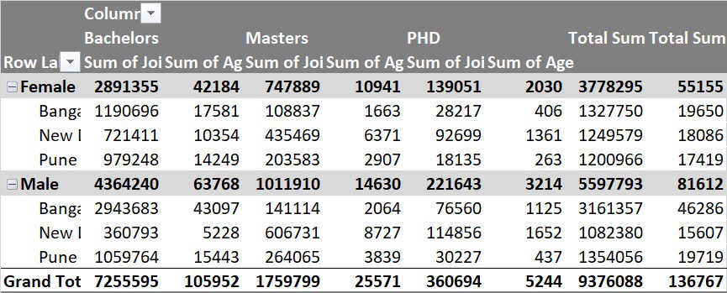
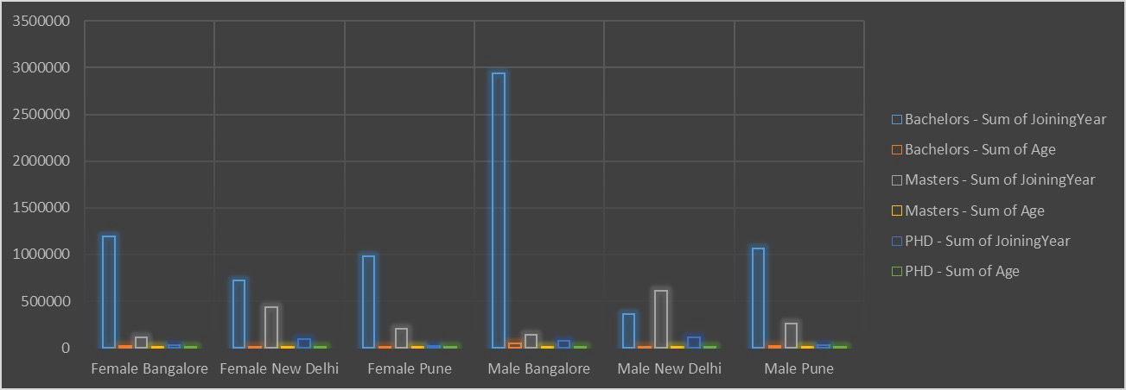
RESULTS
11

Slide 12
conclusion
"In conclusion, the identification of gender is a complex and multifaceted
process that requires a thoughtful and inclusive approach. By recognizing
the diversity of gender identities and experiences, organizations can
create a more welcoming and equitable environment for all individuals.
Through accurate self-identification, robust data analysis, and
responsible modelling, organizations can:- Better understand their
workforce demographics- Identify areas for improvement in diversity and
inclusion- Develop targeted initiatives to address gender disparitiesFoster a culture of inclusivity and respectBy prioritizing gender
identification and analysis, organizations can unlock the full potential of
their workforce, drive business success, and become leaders in diversity
and inclusion. Remember, gender identification is not a one-time task,
but an ongoing process that requires continuous effort, commitment,
and dedication to creating a more inclusive workplace.

